Slide 1

Complaint redressal system (Group-8)

Slide 2
Team members:
FRONTEND TEAM | BACKEND TEAM
Shiva Gaini | Shubham Sanjay Sapkal
Santhosh Sakthivel | Sharath Kumar H R
Talakonda Ravi | Sadana Nandini
Thanneeru Pavan Kumar | Talloju Anuradha
Shubham Kakasaheb jawalkar | S Tharani

Slide 3
CONTENTS
Introduction
Aim of the project
Objectives
Block Diagram
Working
Flow chart
Advantages and disadvantages
Output
Future scope

Slide 4
Introduction
In the “COMPLAINT REDRESSAL SYSTEM” , It provides the solutions for users to get in touch with management and complete work and raise complaints with their issues through this system.
Complaint Redressal System - Web Application, where users can register , Login, raise their issues to the management.
All the complaints arrives from customers are distributed to different departments according to complaints category.
Administrator can see all complaint and individual department complaints.

Slide 5
Aim of the project:
“COMPLAINT REDRESSAL SYSTEM” primarily covers the receipt and processing of complaints from customers, includes actions taken on any issue raised by them to available services.
It provides services for arrived complaint of customers.
Customers can know the currently processing status of their complaint.
This system will be developed on a windows operating system using Java, spring boot, hibernate, my sql.

Slide 6
objectives:
The system will be developed on any windows OS machine using My Sql , hibernate , spring boot Intel Hardware Machine.
Front-End: Angular Js
Server-side: Spring Boot, JPA, Hibernate
Back-end: MYSQL( Xampp )
Web Server: Apache Tomcat

Slide 7
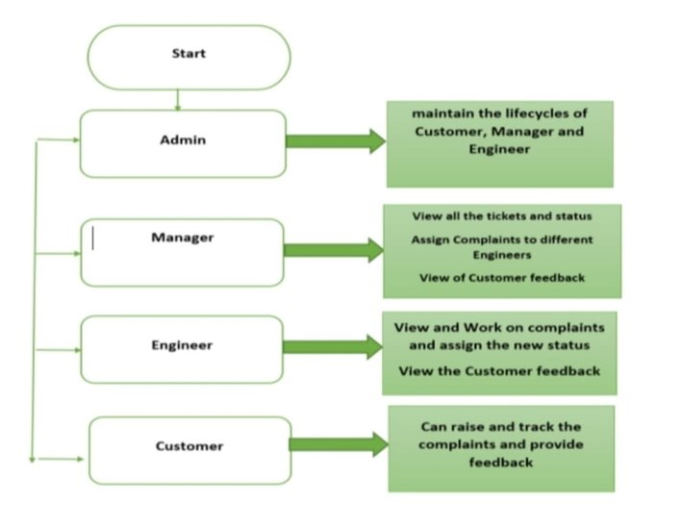
Block diagram:

Slide 8
Working:
The Complaint redreesal System defined ,where in all users need to login successfully before performing any of their respective operations.
The ’COMPLAINT REDRESSAL SYSTEM’ should support basic functionalities for all users like
1. Admin
2. Customer.
3. Manager.
4. Engineer.
Any end-user has been authenticated using a unique user-id and password.
Each user must have valid Email and password.
Server must be running for the system to function.

Slide 9
Working:(continued)
Server must be running for the system to function.
Customer must log in to the system to raised their complaints.
In authorization, the operations supported and allowed based on user type.
For example ,Admin has right to access all the users from this system and he can see all the details of customer , manager and engineer. Whereas Customer and Manager has a right to perform an crud operations like update, delete and add the details from the system.

Slide 10
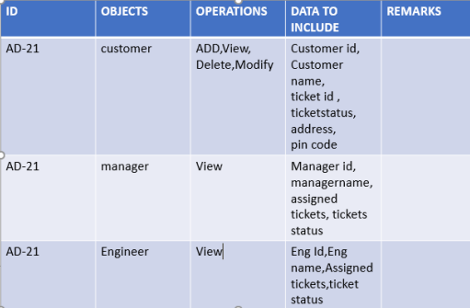
ADMIN :
The Admin as a user is defined to perform below listed operations after successful login.
Enables the customers to login to the portal to raise and track complaints related to the services availed by them
Enables the manager to login, view the complaints raised by the customers and assign the ticket to the engineers based on the PIN Code4
Enables the engineers to pick up the tickets, work on them, enter the status of the task. They can also re-assign it to the Field Workers if they cannot resolve it from the data center.

Slide 11
CUSTOMER:
The Customer as a defined to perform below listed operations after login successfully.
A customer should be able to login/logout. Once logged in, he/she can view the status of the tickets raised by him/her.
The customer also should be able to provide a feedback on the status RESOLVED or ESCALATED.
In case there is a problem, the customer can raise a ticket on the complaint, through say, Register Complaint. Once successfully submitted, the customer should get the ticket number as the acknowledgement.

Slide 12
manager
Managers should be able to login and logout. Once logged in he/she should be able to do the following :
Manager can able to View all the tickets and he can also check the tracking status of the customer complaint
Pick the tickets from the active ticket list and assign them to the engineers based on the PIN code of the customer and Assign Complaints to different Engineers
Should be able to view of Customer feedback

Slide 13
Engineer:
Engineer can able to log in and view all the tickets assigned to him/her.
Pick the tickets assigned to them and assign it the status of ‘WIP”, (work on the case, which is dependent on the type of problem and resolve) and update the status as ‘RESOLVED’.
In case they are not able to resolve the issue at their end, they can remark that this needs to be reassigned to Field Workers in case of a cable fault or at the customers’ site, and flag it as ‘ESCALATED”.
All the activities of all the use cases should be appropriately bound by session or other alternatives. Appropriate time-out to be provided for each user

Slide 14
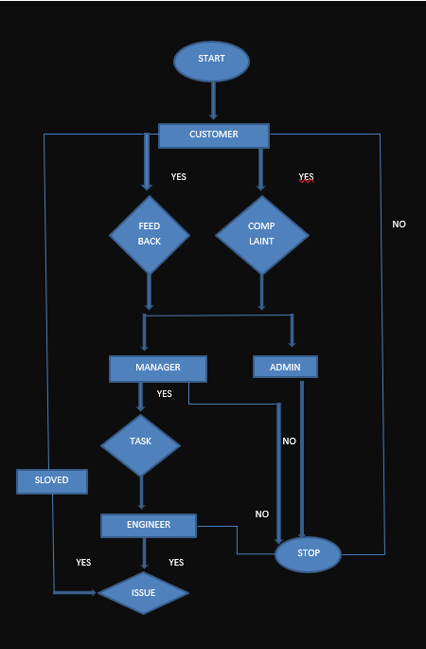
Flow chart:

Slide 15
Postman testing:
Postman is an API client that makes it easy for developers to create, share, test and document APIs.
This is done by allowing users to create and save simple and complex HTTP/s requests, as well as read their responses.
After the completion of backend, we use postman for which help us to check the functionality of the system.
In the postman we explore the operations to add, delete, read, and update the functions with the help of http requests and responses.

Slide 16
J-unit testing:
JUnit is a Regression Testing Framework used by developers to implement unit testing in Java, and accelerate programming speed and increase the quality of code.
JUnit promotes the idea of "first testing then coding", which emphasizes on setting up the test data for a piece of code that can be tested first and then implemented.
If we execute the test cases by tool support, it is known as automated testing.
Provides assertions for testing expected results.
Provides test runners for running tests.

Slide 17
Advantages and disadvantages:
Round the clock availability in comparison to paper-based complain systems.
Allowing reception and redressal of complaints and their solutions in a speedy, transparent manner.
Less time consuming and complaint resolved in short periods.
providing security and developing a sense of confidence to the person who is victimized.
It can be a time consuming process to collate complaints and identify action
It will take time to train all staff in the correct procedure when handling complaints

Slide 18
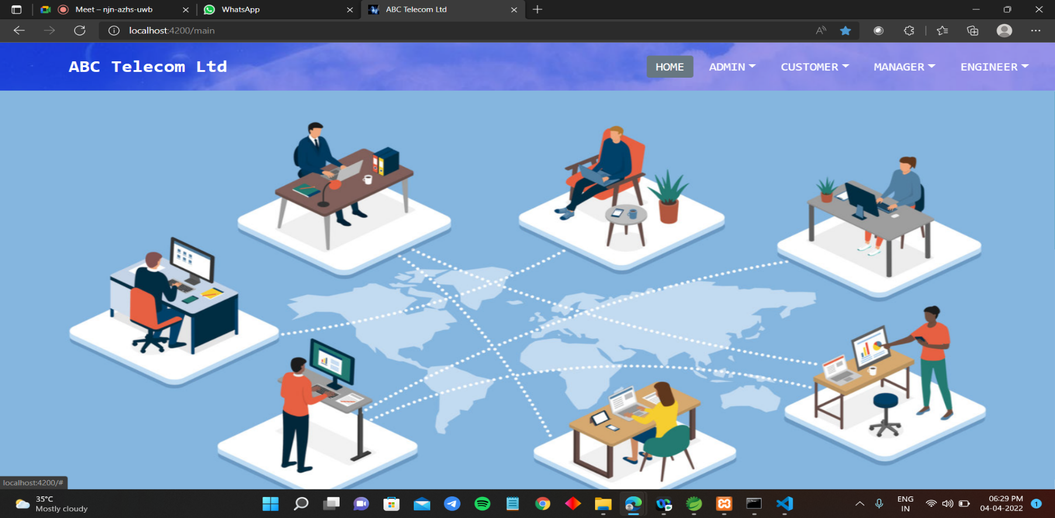
Outputs:

Slide 19
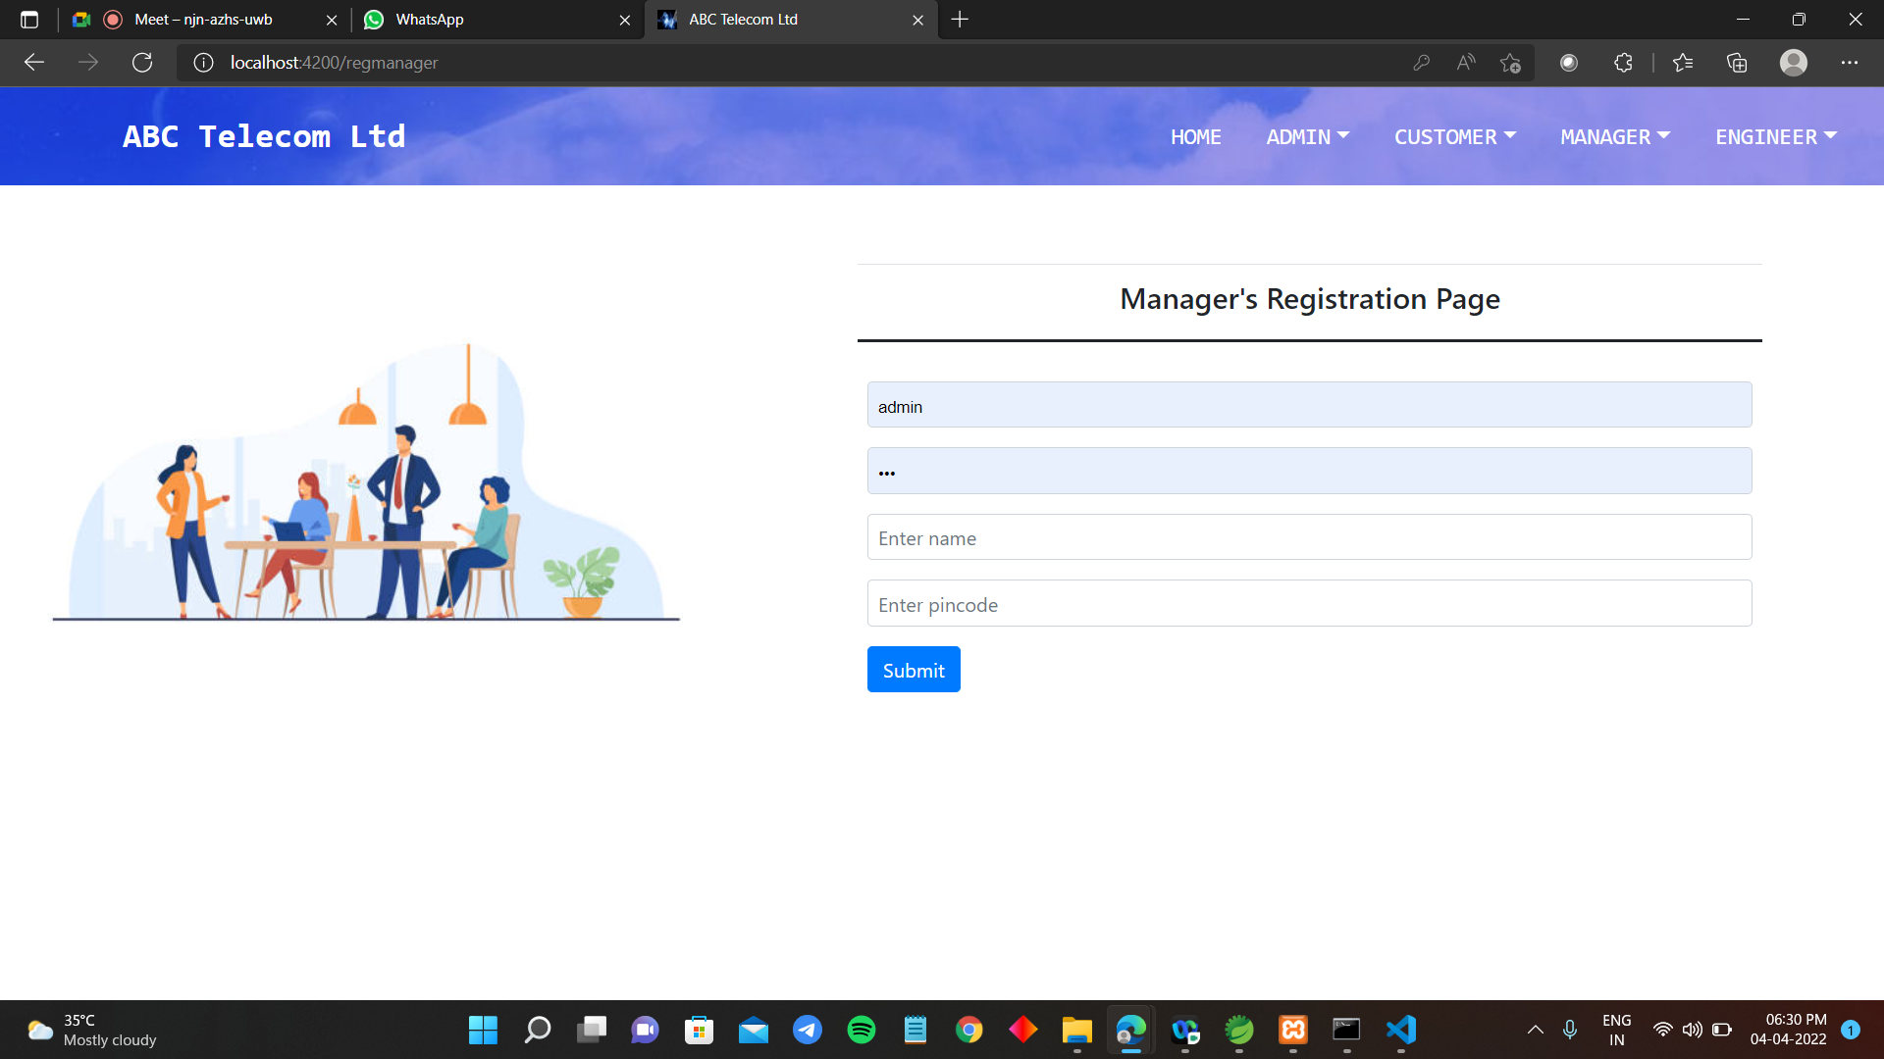

Slide 20
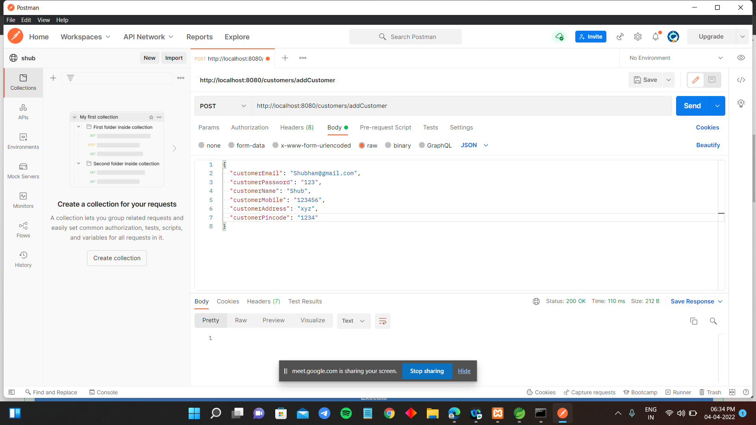

Slide 21
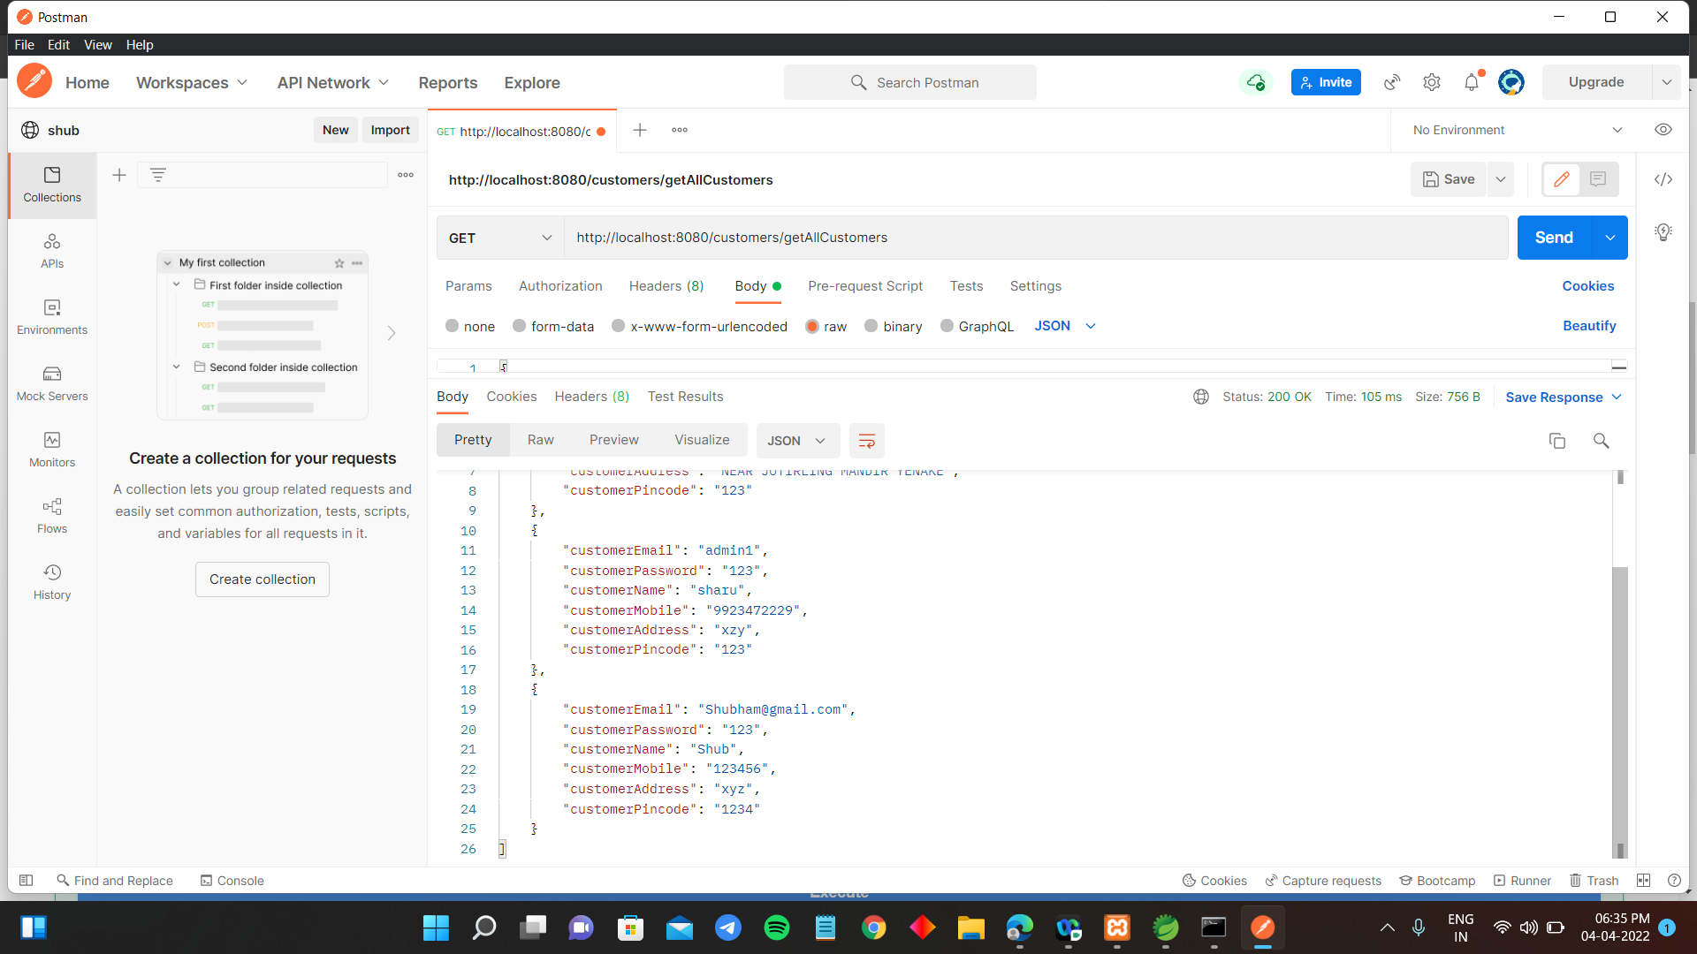

Slide 22
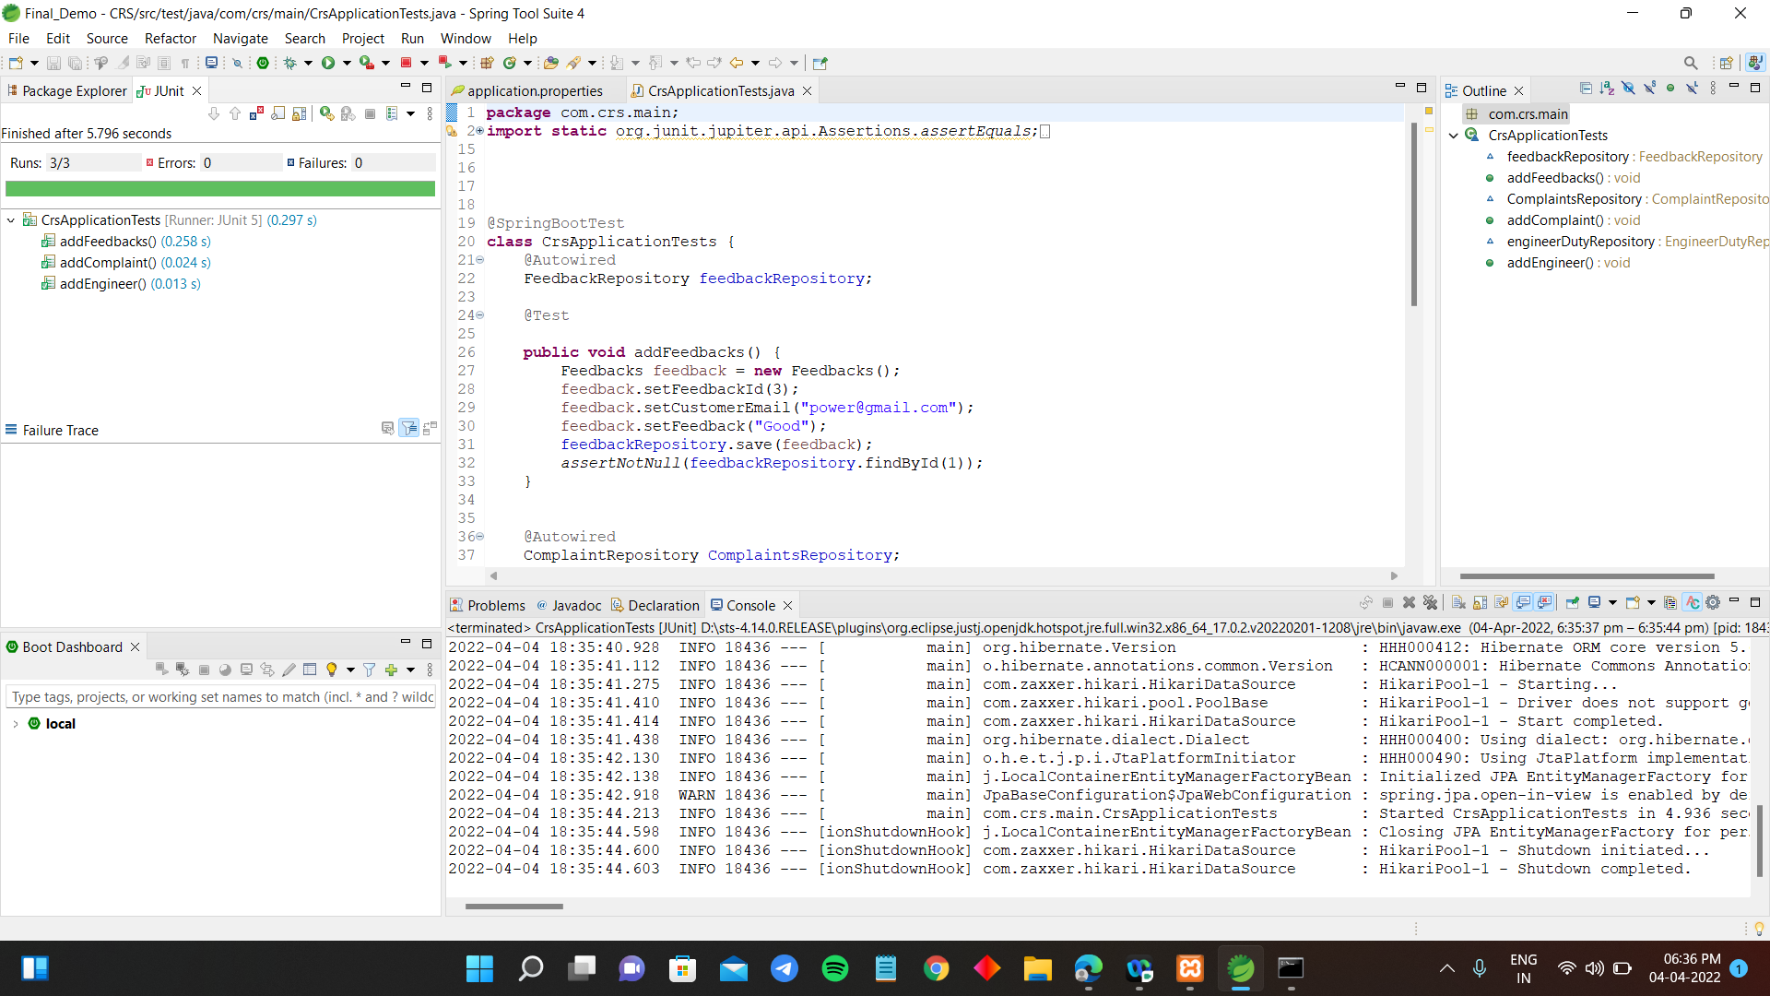

Slide 23
Future scope:
For filling the complaints we use barcode scanner.
If we find any duplicate complaints means similar complaints then users are able to click "agree" instead of creating new complaint.
Receiving complaint via chat box.

Slide 24


